Slide 1

Introducing DevOps

Slide 2
Topics
Understanding DevOps
Building a DevOps culture

Slide 3









Software Development never ends...
Code
Deploy
Plan
Build
Operate
Release
Test
Monitor

Slide 4


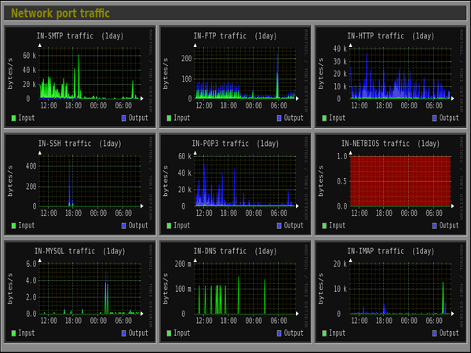
Common Problems DevOps Attempts to Solve
Request for More Server Capacity:
  We need to increase our server capacity to handle the growing demand.
Testing in Production:
  “Wouldn’t it be great if we could test our system directly in the production environment?”
Accountability for Issues:
  An issue has occurred. Who is responsible?
Monitoring System Alerts:
  We get meaningless alerts!

Slide 5
I need more server(node) capacity
The most common complaint from the business
  Ops team are seen as blockers who are not sensitive to the needs of business
Capacity demand often fluctuates without clear reasons
Ops teams manage more than just your app
        🚨 System outages
        🐞 System defects
        🛡️ Incident and Security Management
        💰 Resource and Budget Management
        📈 Monitoring and Improving KPIs
        📜 Compliance
Notes:
I need more server (node) capacity

Slide 6
Another Problem – Who caused it this time?
Production
environment
Who should we
take aim at?
Dev Team
Business
Dev Team: Why can’t build software that works?
Ops Team: Why can’t you get the capacity right?
Notes:
Something went wrong, whose fault was it?

Slide 7
Wall of confusion
The wall of confusion
I want change!
I want stability!
Dev
Op
What about Security, Governance,
Risk Management and Compliance?
OPs wants to maintain stability, availability
Dev wants to create change - Conflicting views
Notes:
Emote/RP this out -
DW and ?

Slide 8
Start-ups – Green Fields
Have a great idea
Develop it
Deploy it

Slide 9
Enterprise – Complexity Due to Scale
Have a great idea
Debate it
Get signed off to process
Develop it
Test it
Fix it
Scope out
requirem-ents
Raise required paperwork
Get paperwork signed off
Fix it
Deploy as part of a release
Fix it
Test it as part of the release
Schedule the release

Slide 10
Devops as a new role?
Devs perspective
CI/CD
First Deployment
Monitored
Tested
Ops perspectives
Virtualisation
Cloud based
High availability
Testable
Maintainable
Reproducible
Notes:
Adrian or Phil?

Slide 11
Development
Testing
Operations
DevOps – We’re all in this together!
DevOps
Notes:
DW

Slide 12
Keep CALMS and do DevOps
DevOps – The C.A.L.M.S Lifecycle:
C – Culture
A – Automation
L – Lean
M – Measurement
S – Sharing
Notes:
https://devops.com/using-calms-to-assess-organizations-devops/
We will investigate these in the next few slides

Slide 13

🎯 Sharing the same vision, goals and incentives
💬 Open, honest, two-way communication
🤝 Collaboration
🏆 Pride of work
🙏 Respect others
🔐 Trust others
🔍 Transparency
Culture

Slide 14
Change of culture
From | To
💻 IT only thinking …………………………......... 🧱 Teams stuck in silos ……………………….. 🎯 Control over collaboration ………….. 📋 Tasks over outcomes ……………………… 👉 Blame instead of learning …………… 🚒 Always firefighting …………………………. 🕰️ Comfort in the past ………………………… 🛑 Change is resisted …………………………….. 🔒 Trust is scarce ……………………………………… 🙈 Mistakes are hidden ………………………… 🧊 New ideas do not survive ……………. | Customer focus Cross-functional teams Collaborative Outcome-oriented Taking on responsibility Proactive Courageous Flexible High trust Share responsibilities, report failure Novelty is implemented
People don't resist change; they resist being changed. Peter Senge

Slide 15
Develop
Test
Release
A – Automation
Tools make automation possible
Amazon push code to production
every 11.7 seconds
Notes:
Automate: deployment, infrastructure, builds, deployment, configuration, document management
Benefits: testability, recoverability, consistency, reduction in workload, fewer incidents, greater accuracy
Netflix is well-known DevOps case study. It can deploy code and software updates in minutes across its entire infrastructure.
Deploying too fast is risky and automation needs to take this into account.
Continuous Integration practices allow for continuously releasable software through incremental build and test.
Code in the 'mainline' branch of the version control system is always ready for release, through the use of automated tests that run whenever a developer checks in their code. Many teams use a dedicated CI environment for this purpose
Continuous Integration, by Paul Duvall, with Steve Matyas and Andrew Glover.
http://martinfowler.com/articles/continuousIntegration.html#PracticesOfContinuousIntegration
http://guide.agilealliance.org/guide/ci.html

Slide 16
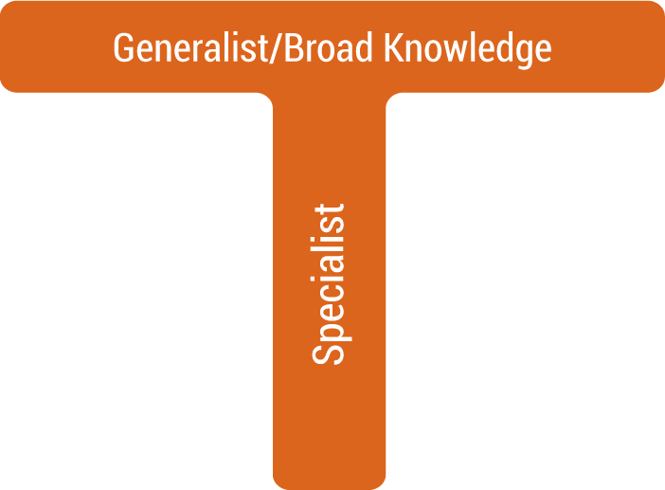

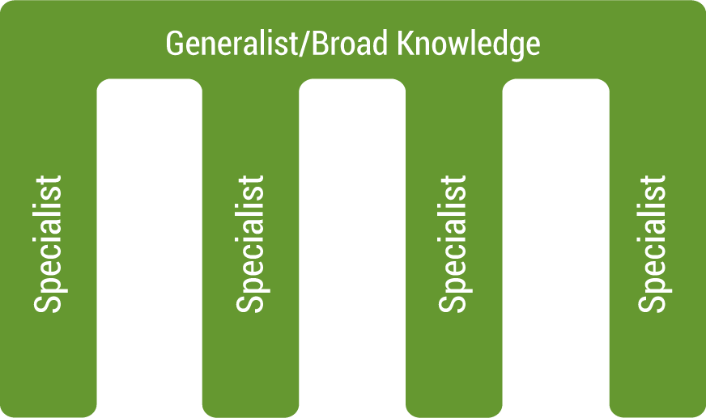
We Need Rounded Professionals
The agile world demands multifaceted teams
  Dev teams should be involved end-to-end

Slide 17
L – LEAN
🗑️ Eliminate Waste
🛠️ Build Quality In
🧠 Create Knowledge
⏳ Defer Commitment
🚀 Deliver Fast
🤝 Respect People
🌍 Optimise The Whole
Notes:
Document cost savings by eliminating unneeded resources. DevOps can help companies with lean operations.
There is always the risk of being too lean and errors.
Respect people: Courtesy, listening, developing people and developing a no blame culture.
7. Maximise profit for the share holders or Creating value for end-use, customers by eliminating waste, unevenness, and being unreasonable.

Slide 18

Continuous Improvement
Continuous improvement
  Kaizen – 'good change’ –
  continuous improvement mindset
Targeting areas for improvement
  Bottlenecks
  Waste elimination
  Reduction of variability
Taiichi Ohno – the father of Lean

Slide 19

We Use Tools for:
🤖 Automation
🎼 Orchestration
⚙️ Configuration
🧪 Testing
📊 Logging and Monitoring
🚀 CI CD

Slide 20
Specification
Test (BDD) code
Exploratory testing
Integration test
Deploy and test
Build and test
Monitor (test)
Test Based DevOps
Notes:
Exploratory testing is an approach to software testing that is often described as simultaneous learning, test design, and execution. It focuses on discovery and relies on the guidance of the individual tester to uncover defects that are not easily covered in the scope of other tests.

Slide 21
THANK YOU
Hope you enjoyed this learning journey.

Slide 22
What is NoOps?
NoOps stands for no operations
IT environment can be so automated and abstracted that no dedicated in-house team is needed to manage software
Main drivers are IT automation and cloud computing

Slide 23
What is WebOps?
WebOps, short for Web Operations
  Focuses on the development, deployment, maintenance, and scaling of web applications. It enhances efficiency and performance through automation and specialised web tools
  The area of WebOps engineering includes:
  Application deployment
  Management
  Maintenance
  Configuration
  Repair

Slide 24
Simian Army
  Software that reap havoc on their production systems
A new approach to architectures – microservices
  Teams must clearly understand what service failure means to the system as a whole
  Live service testing is becoming a new norm –
  Netflix simian army used to test resilience and monitoring
  A lot of real-time monitoring
    Detect – requests/second, and transactions/second
    Respond
  Performing “semantic monitoring”
    Run subset of automated tests against live system
A Lesson from Netflix
Notes:
Latency Monkey induces artificial delays
Conformity Monkey finds instances that don’t adhere to best-practices and removed
Doctor Monkey health checks each instance as well as monitors other external signs
Janitor Monkey makes sure their cloud is running free of clutter and waste (unused resources).
Security Monkey finds security violations or vulnerabilities
Chaos Gorilla simulates an outage

